Slide 1

Integrative Omics
Integrative Analysis of Gene Expression and MicroRNA Expression in Preprocessed TCGA Data for Skin Cutaneous Melanoma (SKCM)
By:
Mohamed elmanzalawi
Menna ramadan
Mohamed aboAlkasem
Presented to: Dr/Mohamed Maysara
By: Mohamed, Mohamed, menna
Presented to: Doctor/Mohamed Maysara

Slide 2
Introduction
Melanoma is a type of skin cancer that develops when melanocytes (the cells that produce melanin which is the pigment give the skin its tan or brown color) start to grow out of control.
The exact cause of all melanomas isn't clear, but exposure to ultraviolet (UV) radiation from sunlight or tanning lamps and beds increases the risk of developing melanoma
Melanoma occurrence is likely a combination of factors, including environmental and genetic factors.
In this TCGA study, we are aiming to provide a large-scale integrative view of melanoma across gene expression and mirna analysis to indicate the hidden factors that may cause melanoma. Also, to indicate which differentially expressed genes and microRNA (transcripts) are up or downregulated in the survival and diseased patients to represent the significant deferentially expressed genes and transcripts that may be used as biomarkers for melanoma skin cancer.

Slide 3
Methodology (miRNA)
The analysis is done using R programming language in one script in R studio.
The aim of this mirna analysis is to indicate which differentially expressed microRNA (transcripts) are upregulated or downregulated in the survival and deceased patients to represent the significant deferentially expressed microRNAs or transcripts that may be used as biomarkers for melanoma skin cancer.
In order to do this differential expression analysis, DESeq2 Bioconductor package is installed and used to represent the differentially expressed transcripts and to measure the log2fold change of these transcripts.
DESeq2 is a tool for differential gene expression analysis of RNA-seq data. It is a new version of DESeq and can detect more differentially expressed genes (DEGs).

Slide 4
Deseq2
The DESeq2 algorithm uses the negative binomial distribution.
DESeq2 performs an internal normalization where geometric mean is calculated for each mirna across all samples. The counts for a mirna in each sample is then divided by this mean. The median of these ratios in a sample is the size factor for that sample. This procedure corrects for library size and RNA composition bias, which can arise for example when only a small number of miRNAs are very highly expressed in one experiment condition but not in the other.

Slide 5
Input Dataset of Deseq2
Deseq2 tool takes as input a table of raw counts, here in our data we have the mirna data file which is this table of row counts that contain the columns as the samples which are 452 samples and the rows as the miRNAs and here we have 1046 miRNAs.
The count table has to be associated with a phenodata or meta data file describing the experimental groups, here in our dataset, the metadata file is the melanoma that includes the columns as the factors and the most important column here is the vital status which is the design that includes the deceased and survival patients, 228 deceased , 254 living and the rows of melanoma metadata include the samples (patients), so the data(mirna), meta data(melanoma) and design(vital status) are the input of deseq2.
We have also 184 Female , 298 Male in the metadata file.

Slide 6
Data Preprocessing
In deseq2, columns of the data must be the same as rows of metadata, So, by R code data preprocessing is done on files of data(mirna) and metadata(melanoma) to intersect the data and meta data in order to make the columns of data same as the rows of metadata and by the same order to apply deseq2.
Also, patients (samples) name are dotted in data and dashed in meta data so it must be the same dashed in both in order to be able to perform deseq2 without any error. This is done by gsub command in R.
In addition, the deseq2 package require the count data values to be integers so the data values are converted by R code to integers and renamed the rows of the data.
Data preprocessing also included removing NA from vital status column that indicates the diseased and survival patients as this column is our design matrix in the input of deseq2.

Slide 7
Pipeline
After creating the deseq of dataset object, the run of pipeline of differential expression steps is done so firstly running the command of deseq2 that specify how many conditions do we want to compare according to the phenotypic table (vital status column in the metadata) so we have 2 conditions the first is deceased and the second is living.
After that, the contrast is specified the to make a result object based on two specific conditions.
Then the most important step after differential expression analysis is to choose the statistical significant differentially expressed transcripts of miRNAs (DETs) based on the p-adjusted value less than 0.05 and biological significance based on the fold change more than 1.2, these results in 3 significant miRNAs that will be reported in the results as a diagnostic biomarker that could affect melanoma and detect it (diagnosis) as the over and down expression (regulation) of these miRNA is significant in melanoma skin cancer for deseased and living patients.
Finally, the last step in methodology is the principle component analysis on vital status and gender 2 columns of meta data for dimensionality reduction of data by clustering the data for better visualization.

Slide 8
Results and Plots (miRNA)
Histogram for visualization of distribution of the data.
Box plot to scale the data by log2 transformation for better visualization, the +1 at the end of command is to avoid the infinity at log the values equal to zero.
QQ plot for testing the normality of the data.
Volcano plot for visualizing the differentially expressed miRNAs.
Heat map to visualize the 3 significant differentially expressed miRNAs.
PCA for multidimensional data visualization for dimensionality reduction and clustering of data(packages used for PCA are tidyverrse, broom, ggbiplot and devtools).
miRNA enrichment analysis (no results in pathways).

Slide 9
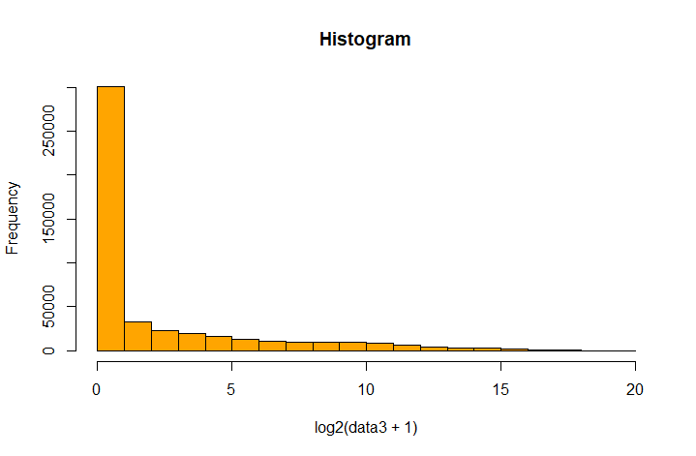
Histogram
histogram for visualization of distribution of the data, the result of histogram plot shows that the data is right skewed, So, it is not normally distributed.

Slide 10
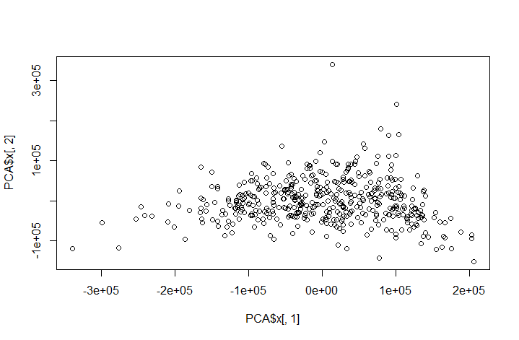
Scatter Plot
Box plot to scale the data by log2 transformation for better visualization, the +1 at the end of command is to avoid the infinity at log the values equal to zero, the result is the same that the data is not normally distributed.

Slide 11
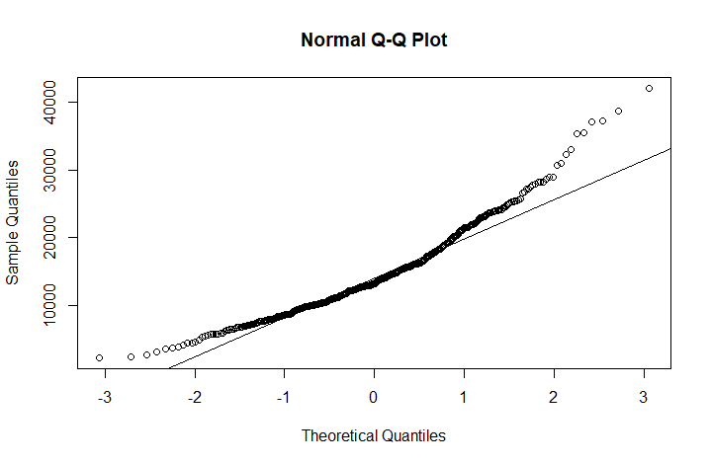
QQ Plot
QQ plot for testing the normality of the data, the results show that the data is not normally distributed as not all the dots are fitted on the line of the QQ norm.

Slide 12
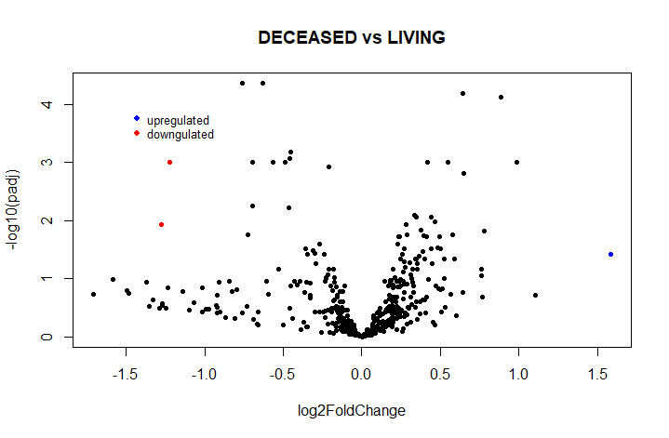
Volcano Plot
Volcano plot for visualizing the differentially expressed miRNAs, the blue color indicates the upregulated differentially expressed miRNAs and the red color indicates the downregulated differentially expressed miRNAs. The total was 3 significant miRNAs that are differentially expressed (significant with p-adjusted value <0.05 and log2foldchange >1.2 (for positive FC upregulated and p-adjusted value <0.05 and log2FC <-1.2 for negative downregulated miRNAs). Here we have 2 miRNAs are down regulated and 1 is upregulated

Slide 13
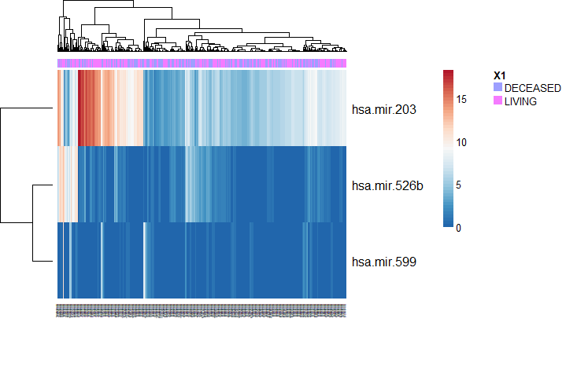
Heat map
Heat map to visualize the significant differentially expressed miRNAs, for p-adjusted <0.05 and log2FC >1.2, the result is 3 significant differentially expressed miRNAs, these significant micro RNAs could be used later as a biomarker as said before in the methodology for detection and affection of melanoma by the down and up regulation of these significant differentially expressed miRNAs. But here in our data, we don’t have case and control we have all are cases but some are dead and some are survived so I couldn’t interpret the results of these 3 significant miRNAs as totally detection or affection of melanoma but it could be a diagnostic biomarker for diseased and living patients.

Slide 14
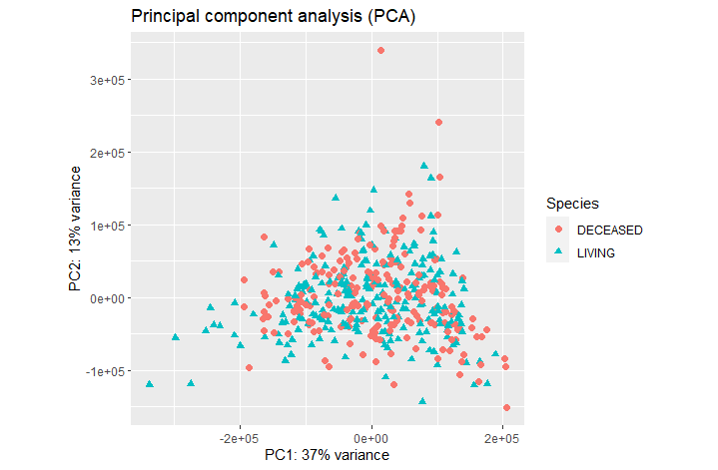
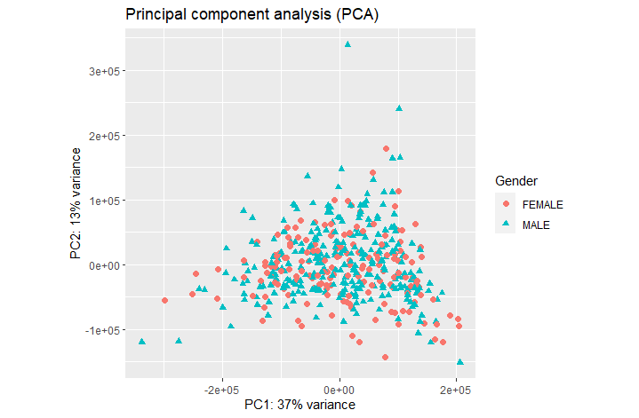
PCA
PCA (principal component analysis) for multidimensional data visualization for dimensionality reduction and clustering data plot results the variability of data is each plot, one for the vital status diseased and living, and one for the gender male and female, the results of the pca shows 37% variance of pc1 and 13% variance of pc2 captured of the total variability of data and it is obvious that pc1 capture more variability of data and have better clustering.

Slide 15
Gene Expression
The gene expression data contain 20531 genes and 473 patient were analyzed in a single R script on R Studio.
Initially, all missing (NA) data was removed from both the gene expression data and the meta data, specifically the vital status, as the gene expression analysis was based on deceased and survived patients.
To intersect the meta data patients and the patients in the expression data, the "-" in the patient names in the meta data

Slide 16
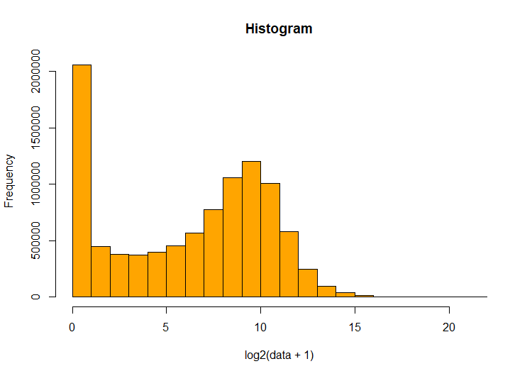
Data Distribution
The gene expression data was analyzed for normal distribution using statistical techniques. A histogram was created to visualize the distribution of the data and assess its normality

Slide 17
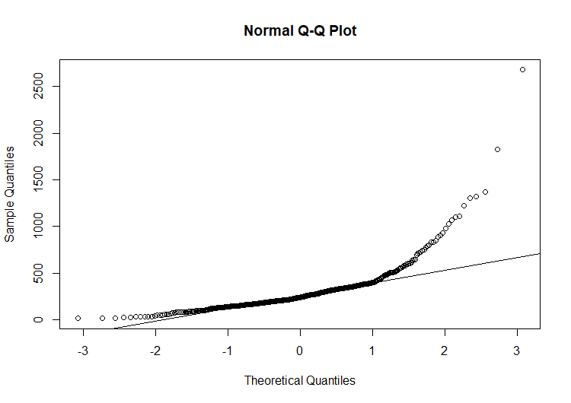
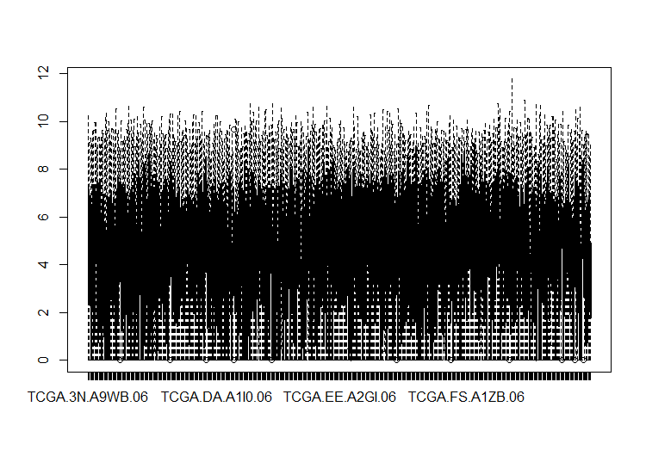
Data Distribution
The results of the histogram were further confirmed by conducting quantile-quantile (QQ) plots and box plots

Slide 18
Differential Expression
Differential expression was performed using DEseq2, the same tool used in miRNA analysis. To ensure the efficiency of DEseq2, the columns of the expression data and the rows of the meta data (sample information) were ordered
Once the results from DEseq2 were obtained, a volcano plot was generated to visualize the most significantly differentially expressed genes in deceased patients by showing the upregulated and downregulated genes. The significance was calculated based on genes with p-values less than 0.05 and log fold changes greater than 1.5

Slide 19
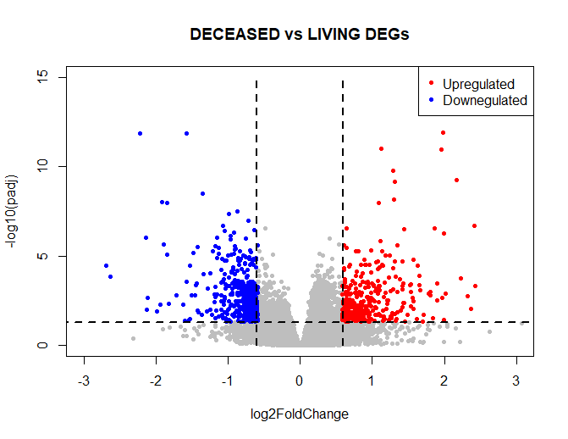
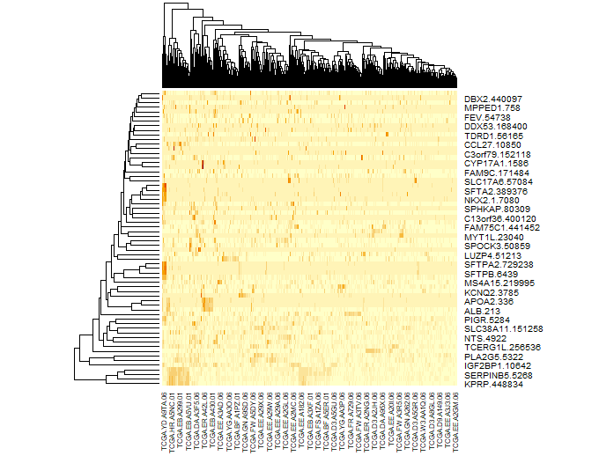
Volcano Plot & heat map
The volcano plot highlighted the genes that are most significantly differentially expressed as the red dots represent the up regulated genes and the blue dots the down regulated genes. A heat map was also generated that showed the most differentially expressed genes

Slide 20
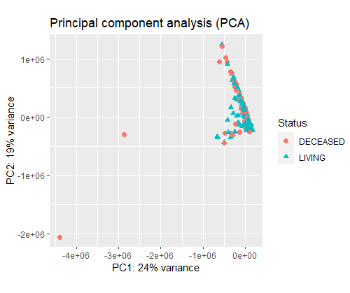
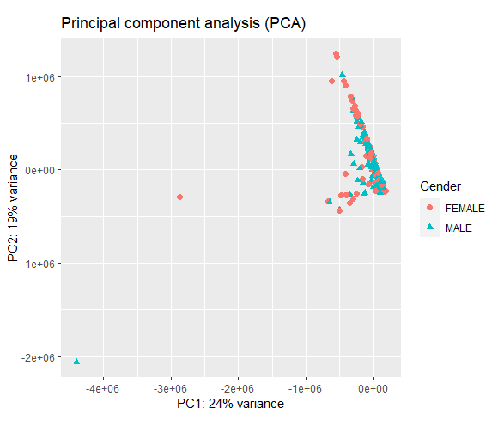
PCA
To investigate the underlying structure of the sample population, a principal component analysis (PCA) was performed using various features present in the meta data, including gender, vital status, and others. The PCA was executed using an R script.

Slide 21
Enrichment analysis
Gprofiler is a web-based platform that conducts gene set enrichment analysis (GSEA) on a given list of genes. The tool utilizes gene-to-function mapping algorithms to identify statistically significant functional terms, such as biological pathways and processes that are over-represented among the input genes.
The results showed significant enrichment of the surfactant metabolism pathway and the colony-stimulating factor receptor A (CSF2RA) gene in the Reactome database, with no hits in the KEGG database

Slide 22
Enrichment analysis
Gprofiler
source | Term_name | Adjusted_p_value
REAC | Diseases associated with surfactant metabolism | 2.21148E-06
REAC | Defective CSF2RA causes SMDP4 | 0.000238463
REAC | Defective CSF2RB causes SMDP5 | 0.000238463
REAC | Surfactant metabolism | 0.000400591
REAC | Diseases of metabolism | 0.016917285

Slide 23
Enrichment analysis
GSEA software Gene Set Enrichment Analysis (GSEA) is a computational approach that evaluates the overrepresentation of a pre-defined set of genes in a given sample or dataset. The method compares the distribution of genes between two distinct biological conditions and determines whether the set of genes exhibits statistically significant differences in expression
The results showed that 27 out of 50 gene sets were enriched in the deceased group. Specifically, the Human Gene Sets HALLMARK_MITOTIC_SPINDLE and HALLMARK_G2M_CHECKPOINT were among the enriched gene sets.

Slide 24
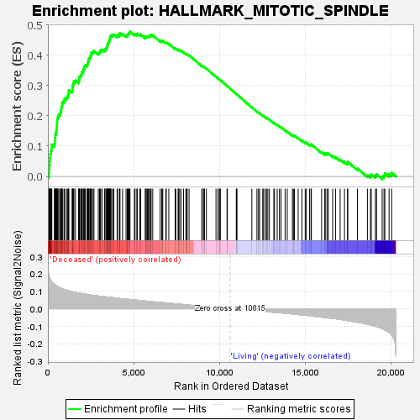
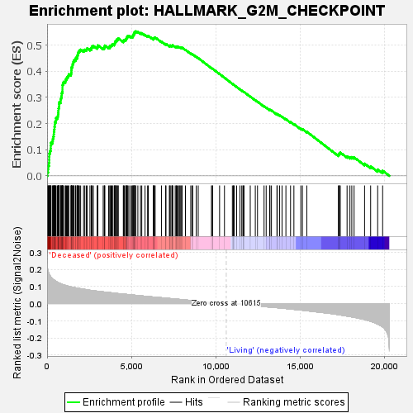
Enrichment analysis
GSEA software

Slide 25
Integrative omics analysis
System biology could be defined as the study of the interactions and behavior of the components of biological entities. So, pooling and contrasting information across studies could give us more comprehensive insights into the complexity underlying biological systems.
Integrative omics are considered the route to understanding system biology.
One of the most powerful tools to conduct integrative omics is Multi-Omics Factor Analysis (MOFA).
MOFA is a type of matrix factorization and mixed factor category. It differs from PCA in the fact that it can infer an interpretable low-dimensional representation in terms of latent factors which could effectively address the relevant signal in the input data. Furthermore, it requires a relatively large sample size of not less than 15 samples also it deals with missing data.

Slide 26
Methods
Loading of data
Preprocessing of data such, as trimming, filtering, and pre-normalizing the data
Visualize the structure of the data
Define the options; Data, Model, and Train option
Build and train the MOFA object
Downstream analysis
Annotation of the Meta Data
Enrichment analysis

Slide 27
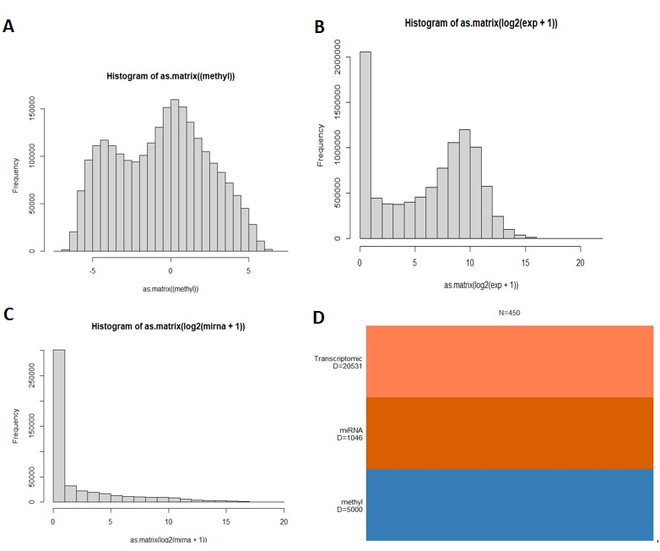
Visualize the structure of the data
Fig. : A, B, and C show the data exploration of different Omics, D shows the number of samples subjected to MOFA analysis.

Slide 28
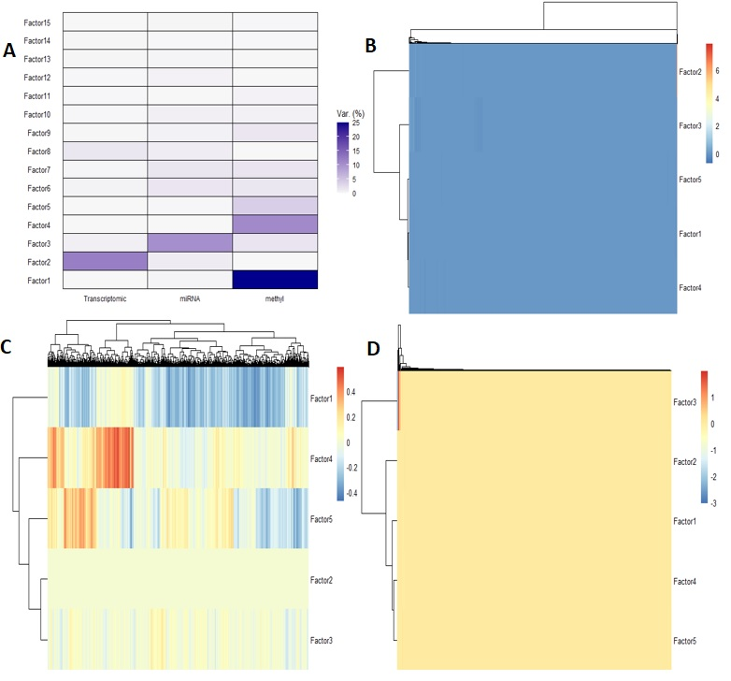
Build and train the MOFA object
Fig. : A; showed variance per each factor, B, C, and D; heatmap plots represent the weight of the first five factors on different omics; transcriptomics, methylation, and miRNA respectively.

Slide 29
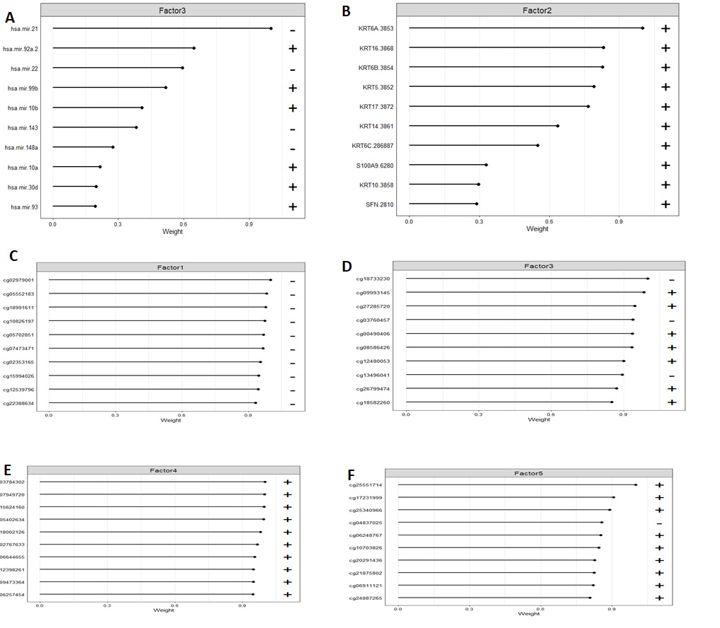
Analysis results

Slide 30
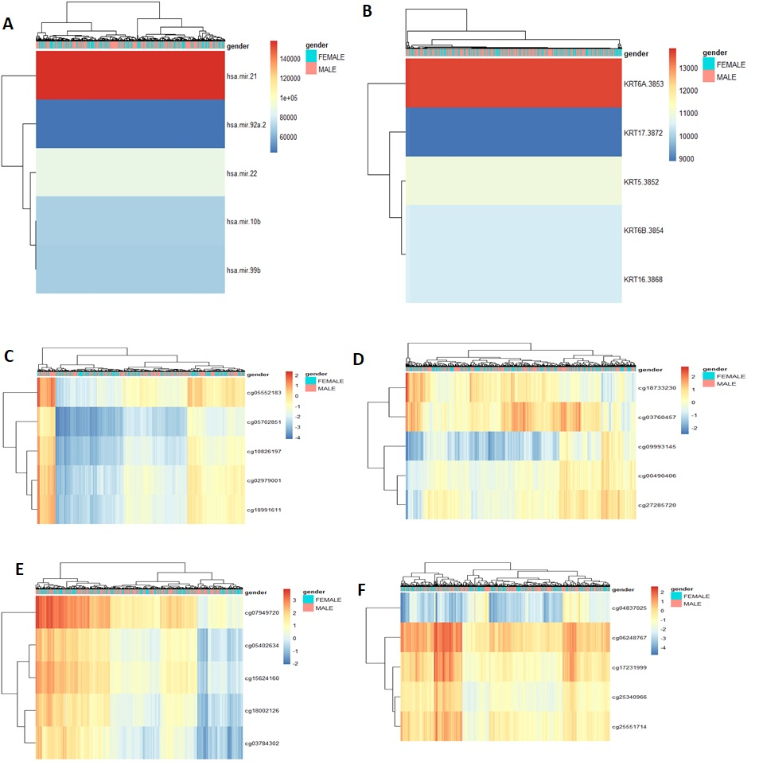
Downstream analysis Annotation of the Meta Data

Slide 31
Downstream analysis Enrichment analysis
Enrichment analysis for the high-weight features (genes) of factor 2 (transcriptomic model) was conducted using gprofiler databases and the results revealed that; according to the GO molecular function those genes correlated mostly to three functions (structural constituent of skin epidermis, structural constituent of cytoskeleton, and structural molecule activity) while, according to GO cellular component those genes correlated mostly to keratinocyte differentiation, keratinization, and epidermis development. However, according to GO biological process, those are correlated mainly to keratin filament, intermediate filament, and intermediate filament cytoskeleton. Additionally, according to Reactome databases, the genes play a vital role in the formation of the cornified envelope and keratinization. On the other hand, there is no obvious pathway according to KEGG databases.

Slide 32
Contribution
Mohamed elmanzalawi: Gene expression
Menna Ramadan: miRNA
Mohamed aboAlkasem: MOFA
(All of us contributed in MOFA code)

Slide 33
Thank you

